Slide 1

Advanced Game Prototyping
GA4401

Slide 2
GA4401
Syllabus

Slide 3

Your great idea
Who cares?
Execution
Adaptability

Slide 4

Working with others
Game Team
Sensitivity
Winning friends and Influencing

Slide 5
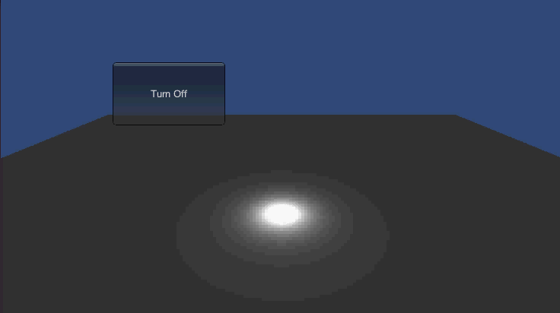
Exercise #1
Light switch
GUI Button
Set Light Intensity

Slide 6
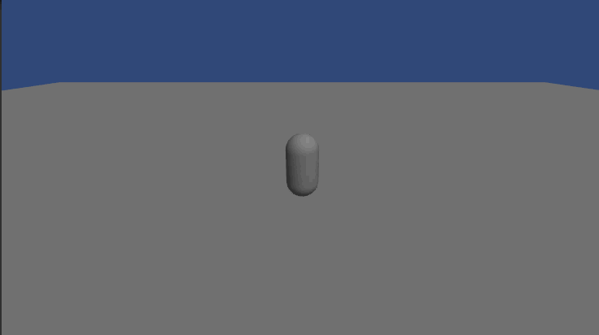
Exercise #2
Character
Get Axis Vector
Controller Simple Move

Slide 7
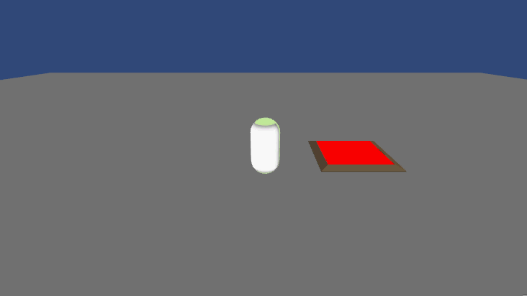
Exercise #3
Triggers
Trigger Event
Create Object

Slide 8
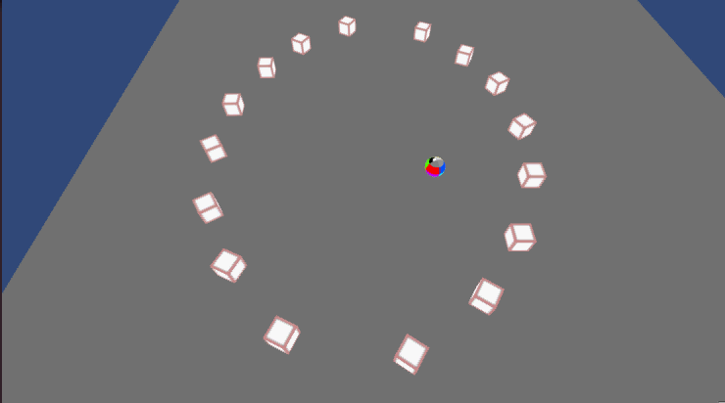
Exercise #4
Game
Character
Triggers
Add Force

Slide 9

Exercise #5
Mouse Pick
Get Mouse Button Down
Mouse Pick
Bool Test
Set Position

Slide 10
In Class
Themes
10 Seconds
Death is Useful
You must leave it behind
Strange Power-ups
Connections
Parallel Worlds
Multi-layered world
Glitch
Survival
Space
Alchemy
Replication
Machines
Corruption
Lifecycle
Evil vs Evil
Alternative Reality
Hunted
Darkness
Surveillance

